Slide 1
Configuring Security and Authentication in SharePoint 2010
Notes:
This module examines the different styles of authentication supported in SharePoint 2010 and introduces terms and concepts of claim-based security. You will learn how to install certificates and configure SSL as well as how to configure Windows authentication, Claims-based authentication and forms-based authentication.

Slide 2
Agenda
SharePoint 2010 Authentication Options
Configuring Authentication Providers
Configuring Web Applications with Multiple URLs
Configuring Forms-Based Authentication (FBA)

Slide 3
Security 101
Authentication and Identity
Authentication creates identity for security principal
Identities stored in user accounts repository
Authentication performed using credentials
Authentication produces some form of badge
Authorization and Access Control
Subsystem used to define security policy
Privileged users configure ACLs on objects
Subsystem enforces policy at run time
Notes:
Windows SharePoint Services does not implement its own system for authentication or identity management, but instead relies solely on external systems, whether Microsoft Windows or non-Windows authentication.
Although SharePoint doesn’t perform authentication, it does manage user identities and perform authorization. After authentication, SharePoint maintains a user security token. SharePoint is able to read the groups and membership roles of the current user very efficiently at run time by examining this token.
SharePoint supports the assignment of permissions to security principals. There are two types of security principals: users and groups. SharePoint checks the user’s security token against binary access control lists.

Slide 4
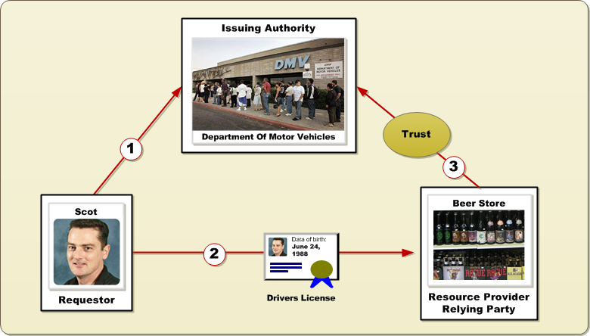
Identity
A profile representing a person or entity
Often verified through some type of document (e.g. drivers license)
Document issued to requester by trusted authority (e.g. DMV)
Requestor presents document to resource provider
Resource provider is 'relying party' which trusts issuing authority
Relying party enforces authorization based on identity attributes
Notes:
Everything about security and authentication begins with the concept of identity. An identity represents a profile that has been verified and documented. A driver's license is a good example. Someone who wants to prove their identity using a drivers license must go to the Department of Motor Vehicles (DMV) which plays the role of an issuing authority. When someone applies for a driver's license, they must bring documents to the DMV and undergo verification checks so the DMV can verify the applicant's identity. Once the DMV has verified the applicant's identity and gone through other tasks (e.g. driving test), it will then produce a driver's license which will serve as proof the holder's identity.
A resource provider (e.g the beer store) who trusts the DMV can assume that attributes on a drivers license are facts and can make decisions authorization decisions based on that information. A resource provider who is making decisions based on information in a security token is often referred to as a "relying party". That is because the resource provider is relying on the information supplied by the issuing authority.

Slide 5
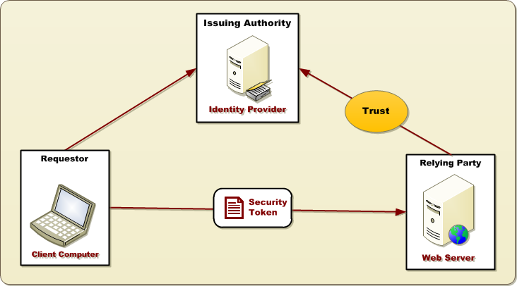
Digital Identity
Identities created/managed by identity provider
Identity provider requires authority to issue security tokens
Relying party uses security tokens to verify identity
Relying Party uses identity to make decision about access control
Notes:
The biggest change when moving to an electronic format for defining and verifying identity involves how to represent it. Instead of using a physical document such as a drivers license of passport, the system will create and use an electronic document known as a security token. Security tokens can in several different sizes in formats. Here is a sampling of the types of security tokens we will discuss in this lecture.
Windows Security Token
Forms-based Authentication (FBA) Token
Security Assertion Markup Language (SAML) token
As in the case of obtaining a drivers license, a security token must be obtained from an issuing authority. The issuing authority has the responsibility of security tokens and using cryptography to ensure that security is not tampered with by another party. The security token will carry attributes that describe the subject (e.g. requestor) such as account name and group memberships. A relying party which trusts the CA can read these attributes and make decisions about whether to allow specific users access to specific resources.

Slide 6
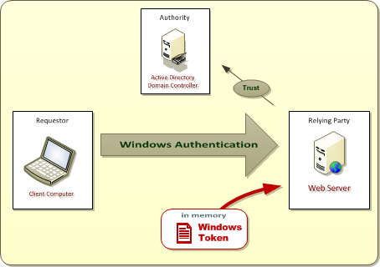
Windows Authentication
Active Directory plays role of Identity Provider
Identities can only established using Windows accounts
OK for intranets scenarios where users are employees
Bad for scenarios which require external users Windows accounts must be created/managed in Active Directory for partners, customers, etc.
Notes:
Windows authentication takes place when users authenticate against the Web server using their Active Directory user accounts. This scenario is very common and well suited for SharePoint farms where all employees already have their own Active Directory account. Windows authentication is less suited for SharePoint farms which must support external users such as partners, vendors and customers.
Windows authentication can be accomplished with several different authentication protocols.
NTLM
Kerberos
Basic
Digest
Client-side SSL certificates
Once a user has authenticated against a Windows account, IIS and Windows Server 2008 respond by creating a Windows security token inside the IIS application pool where the request is running. In a SharePoint server-farm environment, it might be necessary to create same Windows security token and several of the front end Web servers.
Note that SharePoint 2003 supported Windows authentication but nothing else. This is fine for internal sites that were only accessible to employees. However, it did not provide a way to use an identity provider other than Active Directory and therefore was not a good candidate for creating external facing sites for users which did not possess Active Directory accounts.

Slide 7
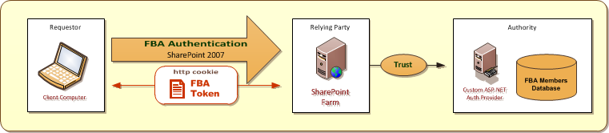
Forms-Based Authentication (FBA)
SharePoint 2007 Introduced Support for FBA
Built on top of FBA support introduced in ASP.NET 2.0
Based on pluggable authentication provider model
FBA Benefits
User accounts can created and managed in custom repository
Authentication token passed via HTTP cookies
FBA Drawbacks
SharePoint provides no support for creating/managing FBA users
FBA token not based on standard – cannot be used across apps
Notes:
WSS 3.0 introduced support for forms-based authentication. This new support in SharePoint 2007 was built on top of the underlying ASP.NET for FBA that was introduced in ASP.NET 2.0.
When the ASP.NET team designed their support for FBA, they built the architecture on top of a pluggable component an ASP.NET authentication provider. The key concept is that one ASP.NET authentication provider can be substituted for another without affecting applications. The authentication provider is hidden under a configuration layer.
In SharePoint 2007, the new support for FBA broke SharePoint's tight coupling to Active Directory and Windows accounts for authenticating clients and created much more flexibility for companies that wanted to authenticate external users without having to create Windows accounts for them.

Slide 8
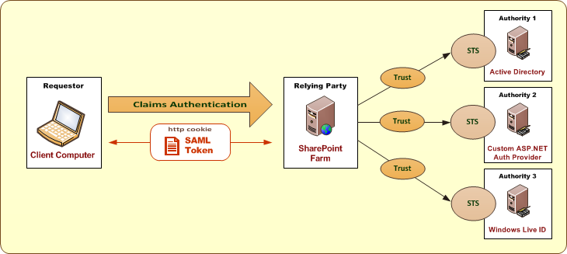
Claims-based Authentication introduced in SharePoint 2010
Based on emerging WS-* security standards
Designed to decouple authorities from relying parties
Authority provides security token service (STS)
STS creates and signs SAML-based security tokens SAML = Security Assertion Markup Language
SAML token used to establish claims-based identity
Notes:
The central concept is that a SharePoint 2010 farm isn’t hard-coded to a specific set of identity providers such as AD and ASP.NET authentication providers. Instead, you can configure trusts in a SharePoint 2010 farm and use any identity provider that you’d like. That is, as long as the identity provider has been designed and implemented in accordance with emerging Internet security standards that are collectively known as the WS-* Security Standards. The actual names of these standards include WS-Security, WS-SecurityPolicy, WS-Trust and WS-Federation.
When customers attempt to log into your web site, they will be redirected to the site for either LiveID or OpenID and prompted to enter their credentials. After they authenticate against the external identity provider, they will then be redirected back to your web site with an established identity. The best part about this approach is that it can be entirely accomplished through configuration, without having to write a single line of custom code.

Slide 9
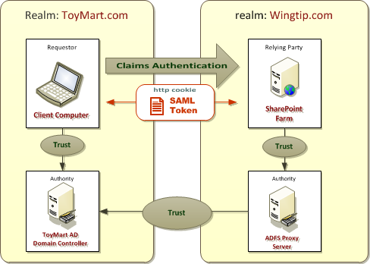
Federating Identity
WS-Federation extends WS-Security
Extends identity across security realms (domains)
Allows authorized access to resources managed in one realm to requesters from other realms
Notes:
Federated identity management is a system that allows individuals to use the same user name, password or other personal identification to sign on to the networks of more than one enterprise in order to conduct transactions.

Slide 10
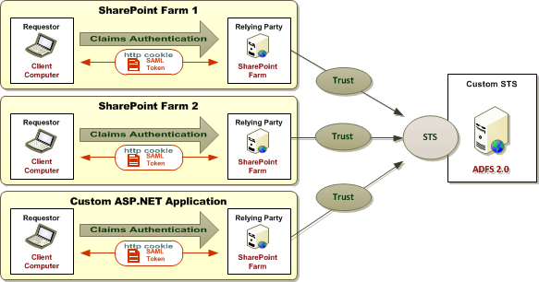
Active Directory Federation Services 2.0 standing up a custom Security Token Service
Provides support to create/deploy custom STS
STS can be configured as custom identity provider
Used for federation or to consolidate user accounts
Also used to create identity transformation services
Notes:
AD FS 2.0 is built on top of Windows Identity Foundation (WIF) and Windows Communication Foundation (WCF).
ADFS helps you use single sign-on (SS0) to authenticate users to multiple, related Web applications over the life of a single online session. ADFS accomplishes this by securely sharing digital identity and entitlement rights across security and enterprise boundaries.

Slide 11
Agenda
SharePoint 2010 Authentication Options
Configuring Authentication Providers
Configuring Web Applications with Multiple URLs
Configuring Forms-based Authentication (FBA)

Slide 12
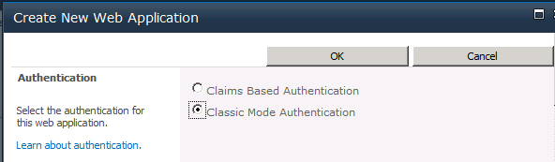
Web Applications and Authentication
Authentication provider selected at Web app creation time
Claims Based Authentication
Classic Mode Authentication
Notes:
When creating a new SharePoint web application you are asked to choose an authentication provider.

Slide 13
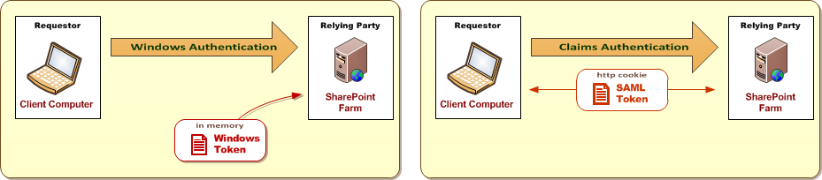
Classic Mode versus Claims Based
What's the same?
Support for Windows authentication with NTLM, Kerberos or Basic
Both support SSL and Anonymous Access
What is different?
Classic Mode relies on Windows tokens created on Web server
Claims Mode passes cookies between browser and Web server
Classic Mode only support Windows authentication
Claims Mode supports Windows authentication and more
Notes:
Classic Mode Authentication: It refers to the integrated windows authentication.
Claims Based Authentication: SharePoint 2010 is built on Windows Identity Foundation. It enables authentication from windows as well as non-windows based systems. This also provides the capability to have multiple authentication in a single URL.

Slide 14

Integrated Windows Authentication
Benefits
Works well inside LAN
Drawbacks
Can only be used reliably for users inside LAN
Doesn't work through firewalls for Internet users
Choices for Integrated Windows Authentication
Negotiate (Kerberos)
NTLM
Notes:
Windows Server supports two different protocols for performing integrating Windows authentication. The older protocol is NTLM and dates back to the days of LAN Manager. The new recommended protocol is Kerberos.
When you want to use Kerberos, you select Negotiate. This means that the client and server will try to authenticate using Kerberos. However, if either the client or server do not support Kerberos, it falls back on using NTLM.

Slide 15
NTLM versus Kerberos
NTLM
Easier to set up
Does not support delegation of credentials
Kerberos
Requires extra set up work
Reduces traffic from Web server to domain controller
Can be configured to support delegation of credentials
Notes:
Both of these protocols are used with Integrated Windows authentication in a classic challenge/response scheme.
NTLM relies on IIS generating a token with a challenge, sending it to the client, the client responding with a token, and a domain controller validating that response. NTLM requires user names and passwords to be encrypted before they are transmitted, and also requires re-authentication (a new token) when accessing a new network resource.
Kerberos relies on a ticketing system where a client and server access a trusted authority called a Key Distribution Center (KDC), which responds to client requests and grants tickets that the client can use to access network resources. Kerberos does not require re-authentication for accessing multiple resources.
NTLM can cause performance issues because NTLM-based authentication inherently requires multiple round trips between IIS and a domain controller for many SharePoint usage scenarios, such as a Web application accessing a SharePoint Web Part or custom Web service. In terms of security, a ticket-based system (Kerberos) with explicit delegation of network resources is more secure by design than only encrypting user credentials. It is also faster because it uses a single ticket to access multiple network resources.

Slide 16
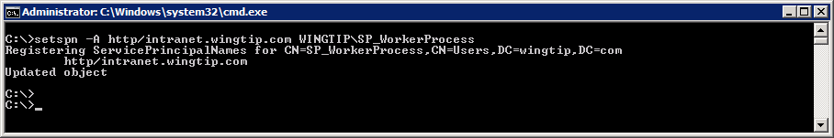
Setting Up Kerberos
Make sure all server clocks are synced
Authentication breaks if clocks > 5 minutes apart
Requires configuration with SETSPN.EXE utility
Registers service provider to support Kerberos ticketing
Notes:
The process of configuring Kerberos authentication for any service installed on a host computer running Windows Server 2008 includes creating a Service Principal Name (SPN) for the domain account used to run the service on the host.
Steps to take:
- Configure Kerberos authentication for SQL communications
Create the SPNs for your SQL Server service account
Confirm Kerberos authentication is used to connect servers running SharePoint Server 2010 to SQL Server
Create Service Principal Names for your Web applications using Kerberos authentication
Deploy the server farm

Slide 17
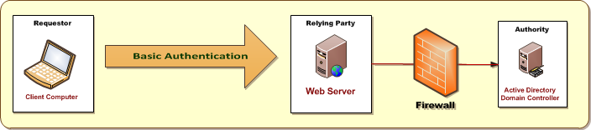
Basic Authentication
Basic Authentication used in Internet scenarios
Allows Windows authentication to work across firewalls
Can be used in Classic Mode or Claims Mode
User name & password sent to Web server in clear text
SSL used to encrypt user name & password as they pass over the Internet
Notes:
Basic authentication requires previously assigned Windows account credentials for user access. Basic authentication enables a Web browser to provide credentials when making a request during an HTTP transaction. Because user credentials are not encrypted for network transmission, but are sent over the network in plaintext, using basic authentication over an unsecured HTTP connection is not recommended. If you choose to use basic authentication, you should always enable Secure Sockets Layer (SSL) encryption.

Slide 18
Agenda
SharePoint 2010 Authentication Options
Configuring Authentication Providers
Configuring Web Applications with Multiple URLs
Configuring Forms-based Authentication (FBA)

Slide 19
Configuring Multiple URLs for a Web App
Prior steps taken outside of SharePoint
Configure DNS for URL with IP address of Web server
Configure DisableLoopbackCheck for Testing Purposes
Configure Web Server with the SSL Certificate
SharePoint provides two configuration options
Configure Alternate Access Mappings
Extend the target Web Application
Notes:
Before you can configure a SharePoint Web Application to support secondary URLs, you must often perform a few configuration steps outside of SharePoint. For example, you might need to configure DNS settings to assign the new URL with a target IP address that points to the Web server. You might need to configure the DisableLoopbackCheck setting in the registry of the Web server for testing purposes. You might also need to configure the Web server with an SSL Certificate so you can configure an URL that uses SSL.
SharePoint provides two configuration options for accessing a Web application through multiple URLs. In this lecture, you will see how to accomplish this using Alternate Access Mappings and by extending the target Web Application.

Slide 20
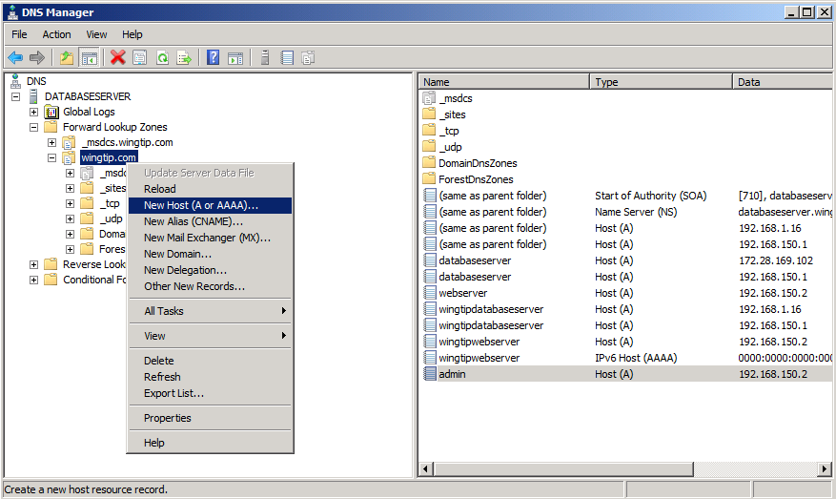
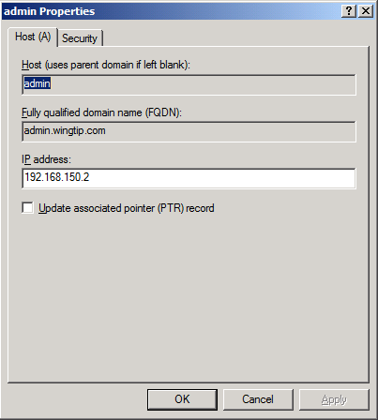
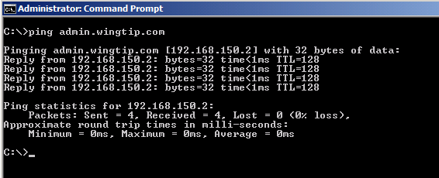
Adding A Records to DNS
New host DNS name requires an A Record
A Record used to resolve domain name to IP address
You can test A Record using ping utility
Notes:
If you want to configure access to a Web application through a specific DNS name, you must ensure that there are DNS settings that redirect requests targeting that DNS name to the IP address of the Web server. You do this by creating a DNS A Record which resolve domain name such as http://intranet.wingtip.com to IP address such as 192.168.150.1.
Once you create a new A Record, you can test it by bring up a command prompt and running the ping command.

Slide 21
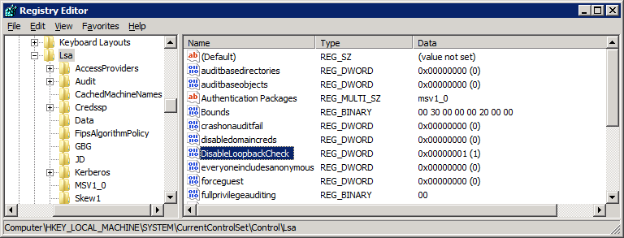
DisableLoopbackCheck
Windows Server has built-in loopback check
Security feature to protect Web server from attack
Web server not allowed to send HTTP requests to self
Loopback check causes problems in testing
Browser running on Web server cannot access sites
Register entry can be used to disable loopback check only to be done on test machines, never on production Web servers
Notes:
Note that this topic is only relevant to testing machines when you need to access sites through the browser while running on the Web server. Windows Server has security features based on a built-in loopback check. The idea of this security feature is that it protects Web server from attack by preventing the Web server from resolving IP addresses that point back to itself. While this is a valuable defensive mechanism on a production Web server, it causes a problem when you are configuring SharePoint and accessing sites through the browser on a single VM.
Since the loopback check causes problems in testing on a single VM, you can disable it in testing scenarios. You can add the DisableLoopbackCheck register entry to disable loopback check. Note that this should only to be done on test machines, never on production Web servers.

Slide 22
Secure Sockets Layer (SSL)
SharePoint farms often required to support SSL
SSL allows browser to authenticate Web server.
SSL encrypts data between browser and Web server
Common scenarios where SSL is used
Basic Authentication
Forms-based Authentication
Claims-based Identity Providers
Notes:
It is common to configure access to SharePoint sites using SSL to encrypt data as it is passed between the browser and the Web server. Configuring SSL also allows browser to authenticate the Web server. The most common scenarios where you will be required to configure SSL include when you use Basic Authentication, Forms-based Authentication and Claims-based Identity Providers.

Slide 23
Certificates and CAs
Certificate Authorities (CAs) issue certificates
CAs are set up in hierarchies
Client browser must trust issuing CA or a parent
Well-known CAs used for Intranet sites
Self-signed Certificates
Commonly used to configure SSL for testing
IIS creates self-signed certificate with machine name
SELFSSL.EXE can create certificate for any URL SELFSSL.EXE is utility that is part of IIS 6 resource Kit
selfssl /n:cn=*.wingtip.com /T /s:1 /P:443 /v:3650
Notes:
In order to configure SSL you must obtain a certificate from a Certificate Authorities (CA). For real world scenarios you will obtain a certificate by making a certificate request to a CA such a VeriSign, Thawte or GoDaddy. For testing scenarios, you can use a utility that is part of the IIS Resource Kit named SELFSSL.EXE that will allow you to create a certificate for an URL such as https://intranet.wingtip.com.

Slide 24
Choosing An Approach
Configuring Alternate Access Mappings
Allows you to configure additional URLs
Requires you to configure settings within IIS
Requires you to backup and restore these IIS settings
Extending a Web Application
Creates additional IIS Web Site for Web Application
SharePoint configures and manages all IIS settings
Notes:
When you need to configure a Web Application to support a new URL, you have two choices. You can configuring Alternate Access Mappings or you can extend the target Web application.
By configuring Alternate Access Mappings , you can configure additional URLs. However, this approach often requires you to directly configure settings within IIS. Note that you might also be required to backup and restore these IIS settings if faced with disaster recovery.
By extending a Web Application, you can also configure additional URLs. When you extend a Web Application, SharePoint creates a new IIS Web Site for Web Application behind the scenes. One valuable aspect of this approach is that SharePoint configures and manages all the IIS settings for you.

Slide 25
Alternate Access Mappings
What are Alternate Access Mappings (AAM)
Maps incoming request to Web Applications
Tells SharePoint Foundation what URL to respond with
AAM are critical in reverse proxy scenarios
Very common source of support calls
Search results link to wrong URL
User redirected to different URL on login
Notes:
SharePoint provides the configuration option of Alternate Access Mappings (AAM) to map incoming request with specific URLs to specific to Web Applications. In scenarios with search, the AAM configuration is important because it informs SharePoint what URL to respond with in the search results.
Alternate Access Mappings are very important in reverse proxy scenarios. They are required to correctly translate the URLs that are sent back to the client in search results. These settings are commonly misconfigured and have resulted in many support calls over the years.

Slide 26
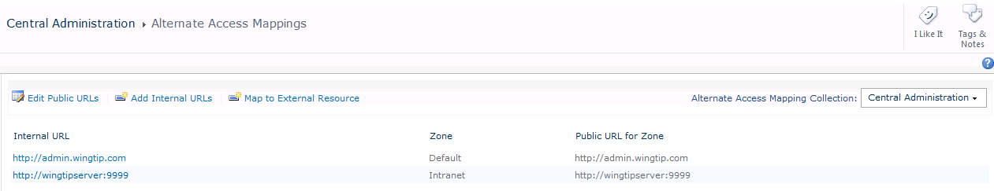
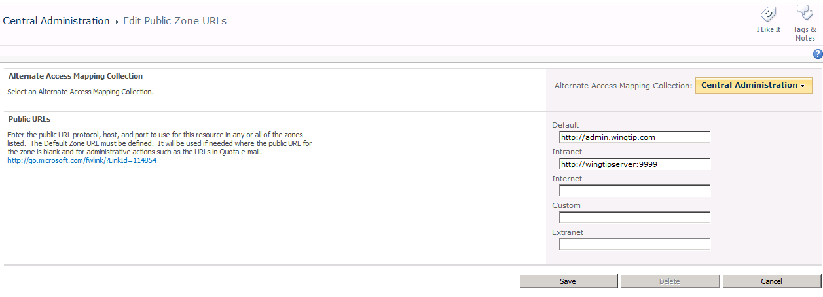
Configuring Alternate Access Mappings
Central Admin provides AAM management
Possible to add multiple public URLs
Notes:
You can go to the Alternate Access Mapping page in Central Administration to see the AAM settings for a specific Web application. You can also change the default URL for a particular Web application. You can also add additional public URLs and internal URLs as well as map incoming URLs to external resources.

Slide 27
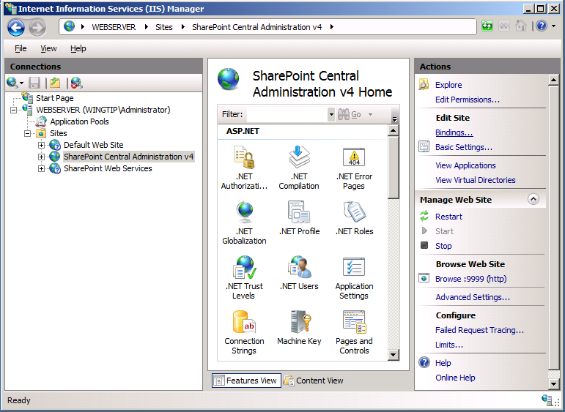
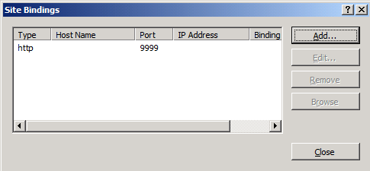
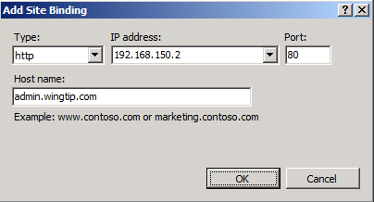
Adding Bindings to the Host IIS Web Site
Configuring AAM alone does not configure IIS
You must add new binding to hosting IIS Web site
Caveat: These IIS settings are neither stored nor backed up by SharePoint
Notes:
When you simply add a new URL as a AAM setting, SharePoint does not automatically configure IIS to properly handle incoming requests targeting that URL. Therefore, you must directly configure the binding settings in IIS to make things work properly. You make these configuration changes by hand in the Internet Information Services (IIS) Manager available in the Windows Start menu in the Administration Tools group. However, you should note that SharePoint has no knowledge of these setting and cannot back them up or restore them.

Slide 28
Extending a Web Application
Web Application is configured with zones
SharePoint creates one IIS Web site for each zone
Web Application always has one "default" zone
You can extend a Web Application with up to 5 zones
Adding zones allows supporting multiple URLs
SharePoint deals with all IIS settings behind the scenes
IIS settings do not have to be backed up independently
Notes:
When you extend a Web Application, SharePoint creates a new zone. SharePoint creates one IIS Web site for each zone. When a Web Application is created, it always has a single "default" zone and you must explicitly extend the Web application to create others. You can extend a Web Application with up to 5 zones.
It is by adding a new zone that allows you to support a new URL within a Web Application. What's nice is that SharePoint deals with creating and track all IIS settings behind the scenes. That means unlike what you have seen with AAM configuration, you do not have to independently backup up and restore IIS settings when you use this approach.

Slide 29
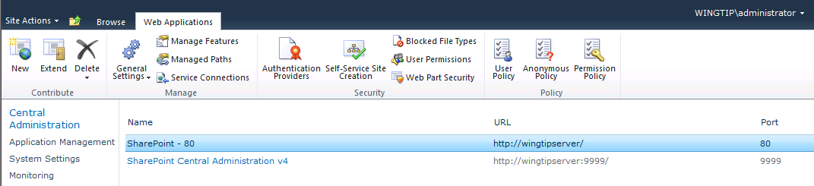
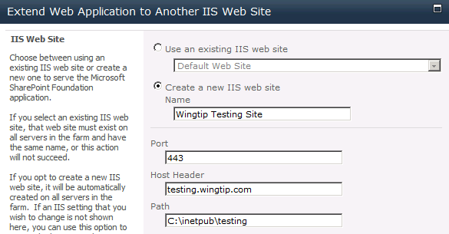
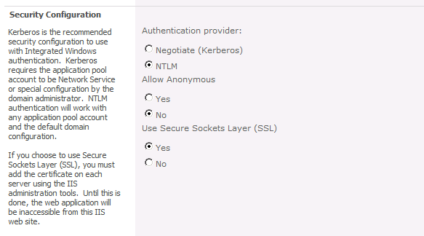
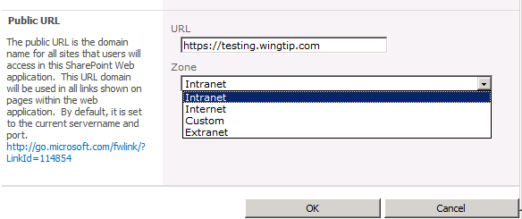
Extending a Web Application
Notes:
This screenshot in this slide shows the user experience in Central Administration for extending a Web application with a new zone. You begin by selecting the target Web application on the Web Applications Management page and then clicking the Extend button. Next, a very tall dialog appears which allows you to enter information for the new zone which is to be created.
The IIS Web Site section allows you to enter the details for the new IIS Web site that is to be created. It is important that you configure the port and host hear for the URL correctly. In a classic Web application, you can also decide whether to use Kerberos, NTLM or Basic Authentication, In a claims-based Web application, you will have additional authentication options as well.
Note that a new zone must be configured as Intranet, Internet, Custom or Extranet. Note that your selection of one of these four options will not actually change any behavior within the new zone. Think of this setting as a descriptive label.

Slide 30
DEMO
Extending a Web Application for SSL Access

Slide 31
Agenda
SharePoint 2010 Authentication Options
Configuring Authentication Providers
Configuring Web Applications with Multiple URLs
Configuring Forms-based Authentication (FBA)

Slide 32
Configuring FBA using a SQL Database
Configuring FBA requires authentication provider
AspNetSqlMembershipProvider is part of .NET FX
Can be used to track members and roles in SQL DB
Steps to make it work with an ASP.NET app
Create database using aspnet_regsql.exe
Configure DB permissions for required accounts
Modify web.config file
Notes:
Please see the following URL for a complete discussion on configuring FBA authentication.
http://msdn.microsoft.com/en-us/library/bb975136(v=office.12).aspx

Slide 33
Summary
SharePoint 2010 Authentication Options
Configuring Authentication Providers
Configuring Alternate Access Mapping
Configuring Forms-based Authentication (FBA)

